Slide 1

File System
Design and Optimizations
Computer System Engineering, Fall 2019. (IPADS, SJTU)
File System, New Media
Yubin Xia

Slide 2
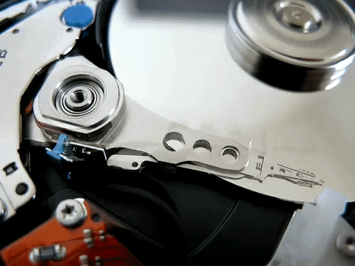
Review: Disk Structure
Fig. from https://www.cs.uic.edu/~jbell/CourseNotes/OperatingSystems/10_MassStorage.html
and https://www.youtube.com/watch?v=BlB49F6ExkQ

Slide 3
Review: Disk Characteristics
Rotation speed
  5400/7200 rpm
Seek time
  ~ms
Slow random access
Fig. from https://www.cs.uic.edu/~jbell/CourseNotes/OperatingSystems/10_MassStorage.html
and https://www.youtube.com/watch?v=BlB49F6ExkQ
Notes:
Rotation latency max 8 ms, avg 4 ms for 7200 RPM.

Slide 4
File system design and optimizations
How to design and optimize file systems?

Slide 5
File System Design Dimensions
Performance
  Latency/tail latency/throughput/scalability
  Aged performance
Crash consistency
Recovery
Reliability
  Robustness, wear-leveling, fragmentation, ...
...
Notes:
Q: What is important for a file system?
Think like a user, an app programmer, and a system programmer.
Memory consumption, storage consumption, compatibility, hybrid storage, bad block mgmt

Slide 6
Review: UNIX File System
Free block list
Superblock
Inode table
...
...
...
...
inode
triple indirect block
double indirect block
indirect block
block
Notes:
Storage media: a linear space

Slide 7
UNIX File System Issues
SLOW!
  Default 512B blocks
  2% of max disk bandwidth (~20KB/s)
Solution: 1024B blocks
  >2X higher bandwidth (~40KB/s)
  Review: Block size: a trade-off
    Neither too small or too big
  Q: What will happen if the block size is too small? What if too big?
Notes:
Each data transfer is twice large;
Files use less indirect blocks

Slide 8
UNIX File System Issues
STILL SLOW!
  175KB/s at first
  30KB/s after a few weeks
WHY?
  Random access! <= fragmentation

Slide 9
UNIX File System Issues
STILL SLOW!
  175KB/s at first
  30KB/s after a few weeks
WHY?
  Random access! <= fragmentation
Free block list
...
Superblock
...
...

Slide 10
UNIX File System Issues
STILL SLOW!
  175KB/s at first
  30KB/s after a few weeks
WHY?
  Random access! <= fragmentation
Free block list
...
Superblock
...
...

Slide 11
UNIX File System Issues
  175KB/s => 30KB/s
  Random access! <= fragmentation
Solution?
  Defragmentation: rebuild/reorganize
  Pros? Cons?
Free block list
...
Superblock
...
...

Slide 12
A Fast File System for UNIX (1984)
Same as UNIX File System (same file header and triply indirect blocks), except incorporated ideas from Cray Operating System:
  Uses bitmap allocation in place of freelist
  Attempt to allocate files contiguously
  10% reserved disk space
  Skip-sector positioning (mentioned later)
Slides from CS162 © UCB Fall 2018

Slide 13
A Fast File System for UNIX (1984)
Problem: When create a file, don’t know how big it will become (in UNIX, most writes are by appending)
  How much contiguous space do you allocate for a file?
  In FFS, just find some range of free blocks
    Put each new file at the front of different range
    To expand a file, you first try successive blocks in bitmap, then choose new range of blocks
  store files from same directory near each other
Allocation and placement policies
Slides from CS162 © UCB Fall 2018

Slide 14
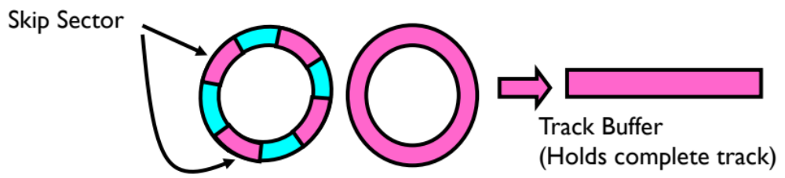
Attack of the Rotational Delay
Problem 2: Missing blocks due to rotational delay
  Issue: Read one block, do processing, and read next block.
  In meantime, disk has continued turning: missed next block!
Solution 1: Skip sector positioning (“interleaving”)
  Place the blocks from one file on every other block of a track: give time for processing to overlap rotation
  Can be done by OS or in modern drives by the disk controller
Slides from CS162 © UCB Fall 2018

Slide 15
Attack of the Rotational Delay
Solution 2: Read ahead: read next block right after first, even if application hasn’t asked for it yet
  This can be done either by OS (read ahead)
  By disk itself (track buffers) - many disk controllers have internal RAM that allows them to read a complete track
Note: Modern disks + controllers do many things “under the covers”
  Track buffers, elevator algorithms, bad block filtering
Slides from CS162 © UCB Fall 2018

Slide 16
Where are inodes stored？
In early UNIX and DOS/Windows’ FAT file system, headers stored in special array in outermost cylinders
Header not stored anywhere near the data blocks
  To read a small file, seek to get header, seek back to data
Fixed size, set when disk is formatted
  At formatting time, a fixed number of inodes are created
  Each is given a unique number, called an “inumber” (ino)
Slides from CS162 © UCB Fall 2018

Slide 17
Where are inodes stored？
FFS moved the header information to be closer to the data blocks
  Often, inode for file stored in same “cylinder group” as parent directory of the file (makes an ls of that directory run fast)
Pros:
  For small directories, can fit all data, file headers, etc. in same cylinder => no seeks!
  File headers much smaller than whole block (a few hundred bytes), so multiple headers fetched from disk at same time
  Reliability: whatever happens to the disk, you can find many of the files (even if directories disconnected)
Slides from CS162 © UCB Fall 2018

Slide 18
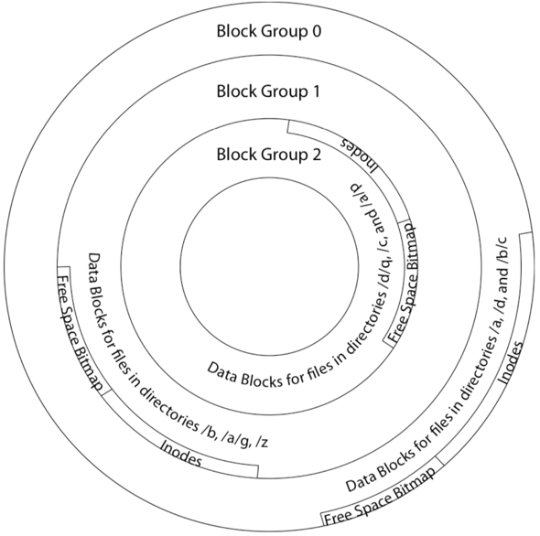
FFS: Cylinder group (block groups)
File system is divided into a set of block groups
  Close set of tracks
Data blocks, metadata, and free space
interleaved within block groups
  Avoid huge seeks between user data
  and system structure
Put directory and its files in common
block group
Slides from CS162 © UCB Fall 2018

Slide 19
FFS: Cylinder group (block groups)
First-free allocation of new file blocks
  To expand file, first try successive blocks in
  bitmap, then choose new range of blocks
  Few little holes at start, big sequential
  runs at end of group
  Avoids fragmentation
  Sequential layout for big files
Important: keep 10% or more free!
  Reserve space in the Block Group
Slides from CS162 © UCB Fall 2018

Slide 20
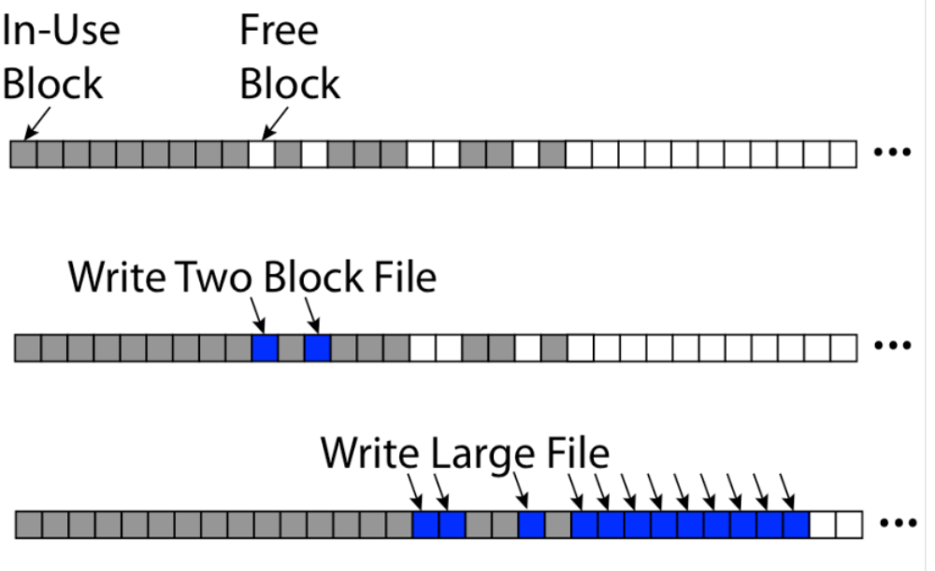
FFS: First-fit Block Allocation
Slides from CS162 © UCB Fall 2018

Slide 21
Fast File System
Pros
  Efficient storage for both small and large files
  Locality for both small and large files
  Locality for metadata and data
  No defragmentation necessary!
Cons
  Inefficient for tiny files (a 1 byte file requires both an inode and a data block)
  Inefficient encoding when file is mostly contiguous on disk
  Need to reserve 10~20% of free space to prevent fragmentation
  Q: How to improve?
Slides from CS162 © UCB Fall 2018

Slide 22
MEDIA and Storage
The history and the future

Slide 23
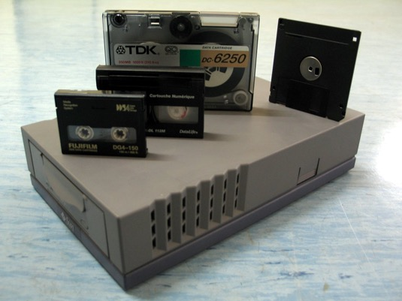
Storage Media
Floppy disk (3.5”, 5.25”）
Tape
CD/DVD
HDD
Flash/SSD
NVM
Notes:
https://stackoverflow.com/questions/1019573/save-icon-still-a-floppy-disk
https://royal.pingdom.com/the-history-of-computer-data-storage-in-pictures/

Slide 24
Flash & SSD

Slide 25
NOR vs. NAND Flash
NOR Flash
  NOR gate
NAND Flash
  NAND gate
Fig. from https://www.embedded.com/design/prototyping-and-development/4460910/Flash-101--NAND-Flash-vs-NOR-Flash

Slide 26
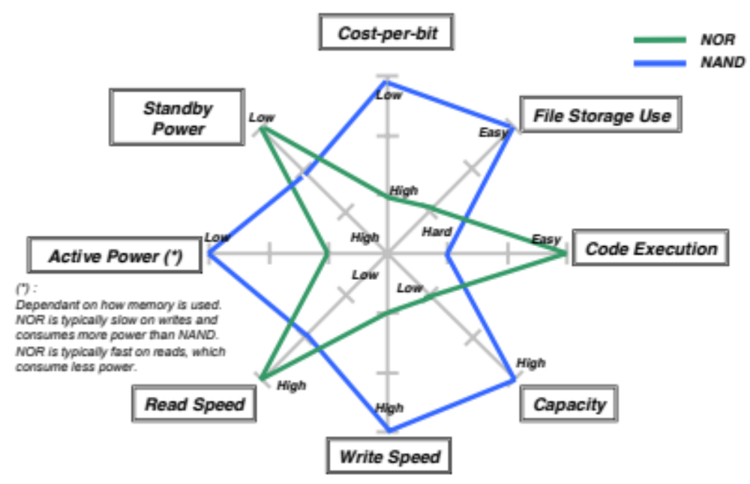
NAND vs. NOR
Fig. from Toshiba NAND vs. NOR Flash Memory Technology Overview

Slide 27
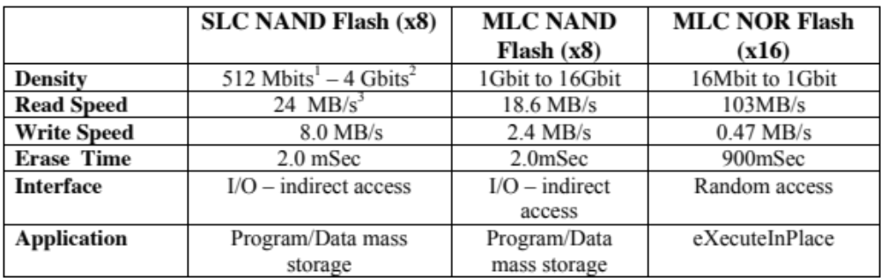
NAND and NOR Operating Specifications
Table from Toshiba NAND vs. NOR Flash Memory Technology Overview

Slide 28
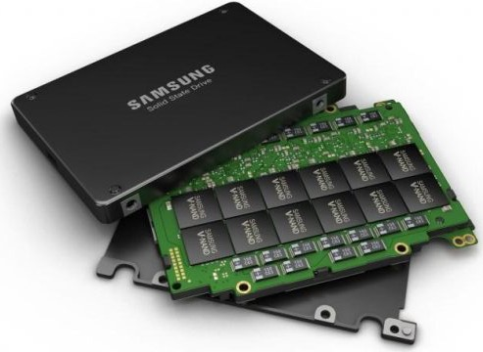
Flash Disk Organization
(NAND) Flash disk organization
  A chip/package
  => 1/2/4 dies
  => 1/2 planes
  => n blocks
  => n pages
  => n cells
  => 1/2/3/4 levels
Fig from https://www.extremetech.com/electronics/274944-samsungs-new-v-nand-could-mean-cheap-plentiful-multi-terabyte-ssds

Slide 29
Flash Disk Organization
Channel
  The number of flash chips the controller can talk to simultaneously
Multi-channel
  Low-end: 2/4 channels
  High-end: 8/10 channels
Fig. from https://www.cactus-tech.com/resources/blog/details/solid-state-drive-primer-8-controller-architecture-channels-and-banks/

Slide 30
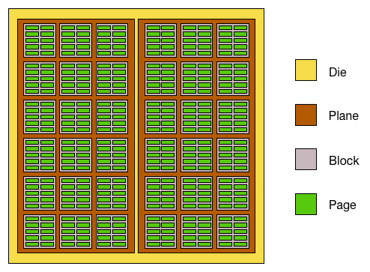
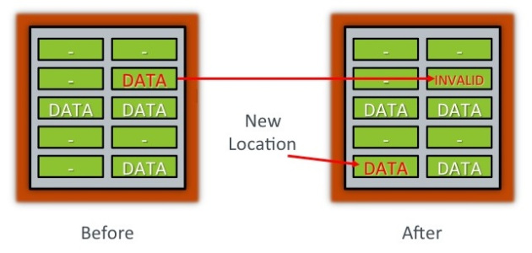
Flash Disk Characteristics
Asymmetric read/write and erase operations
  A “page” is a unit of read/write (8-16KB)
  A “block” is a unit of erase (4-8MB)
Program/Erase cycles
  Erase-before-write restriction
  The number of erase cycles allowed for each block is limited

Slide 31
Flash Disk Characteristics cont’d
Random access
  Disk file system are optimized to avoid disk seeks whenever possible
  Flash device impose no seek latency
Wear leaving
  Flash device tend to wear out when a single block is repeatedly overwritten
  Designed to spread out writes evenly
Heterogeneous cells
  SLC (single level cell) and MLC (multi level cell), TLC, QLC
Multi-channel
  High Parallelism

Slide 32
Flash for File Storage
Simplest method – direct 1:1 mapping
  Good for read-only operations
  No wear-levelling
  Very unsafe (on power loss)
Flash Translation Layer (FTL) keeps track of sectors
  Suitable for a writable FS
  Wear levelling, reliable operation
  But, one journaling FS on top of the other

Slide 33
Open-channel SSD
Hardware FTL
  Easy to use
  Less flexibility
Software FTL: Open-channel SSD
  More flexibility with data placement, overprovisioning, scheduling, garbage collection, and wear leveling

Slide 34
SMR
Shingled magnetic recording
Slides from SMaRT: An Approach to Shingled Magnetic Recording Translation, FAST ’17

Slide 35
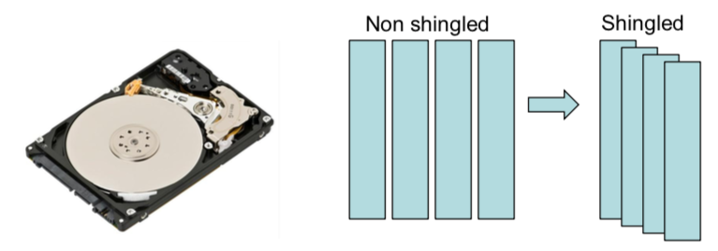
SMR
Traditional HDDs (perpendicular magnetic recording) are reaching areal density limit
Shingled magnetic recording (SMR) is a new promising technology by overlapping tracks

Slide 36
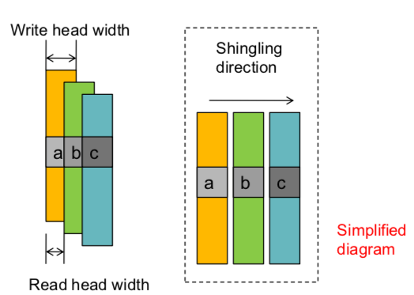

SMR Characteristics
Write head width is larger than read head width
Write/update a block in place may destroy the valid data on the subsequent tracks if any
Sequential write is preferred

Slide 37
Current Types of SMR Drives
Device-Managed SMR (DM-SMR)
  The device handles address mapping
  Block I/O interface
  Drop-in replacement for HDDs
  E.g., Seagate 8TB Archive
Host-Aware SMR (HA-SMR) – T10 and T13
  The host is preferred to follow I/O rules (e.g., writing data sequentially to the location of write-pointer in each zone)
  I/Os violating the rules will be processed in a DM-SMR way. i.e., go to persistent cache
Host-Managed SMR (HM-SMR) – T10 and T13
  The host has to strictly follow rules
  I/Os violating the rules will be rejected
  E.g., WD/HGST 10TB UltraStar Ha10
Notes:
T10- T13 two command sets

Slide 38
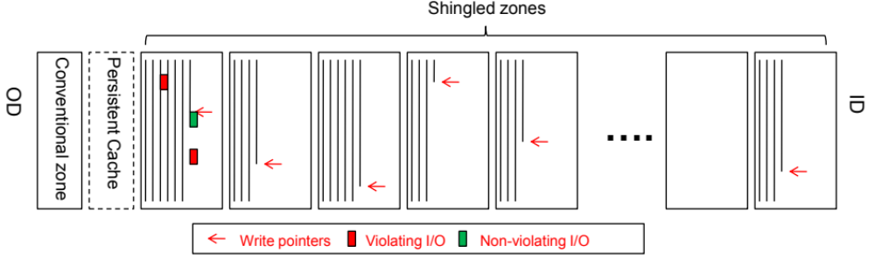
Basic Layout of SMR Drives
Conventional Zones
  Miscellaneous usages: metadata, journal, etc.
Shingled Zones
  DM-SMR: Present a consecutive logical space to host
  HM-SMR: Sequential write required zones (fail violating I/Os)
  HA-SMR: Sequential write preferred zones (direct violating I/Os to cache, GC later)

Slide 39
NVM
Non-volatile memory

Slide 40
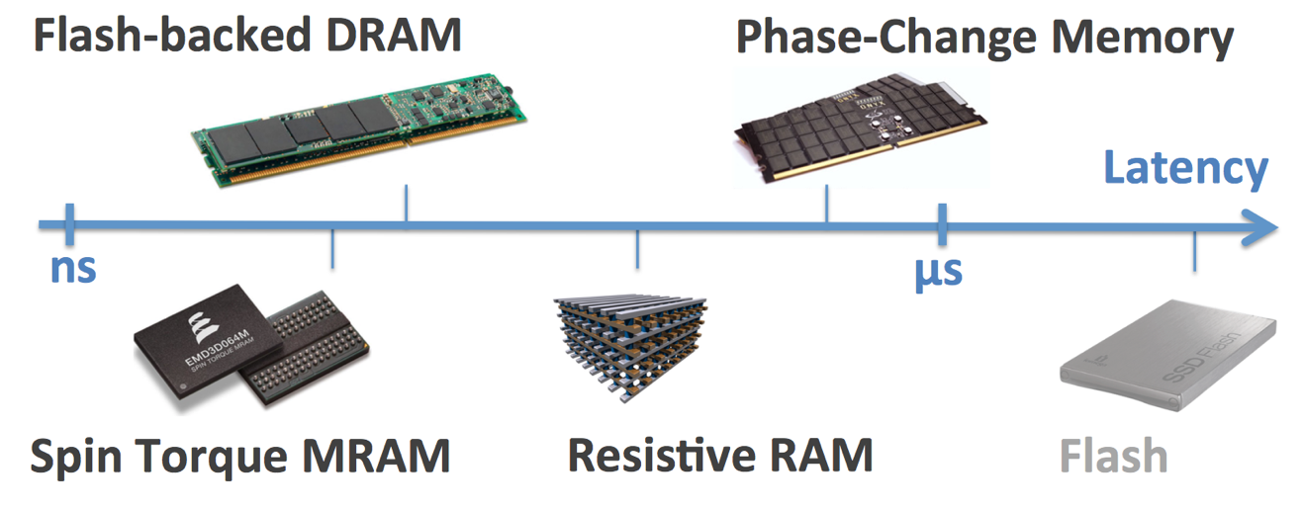
NVM Technologies
Persistent
Short access time
Byte addressable

Slide 41
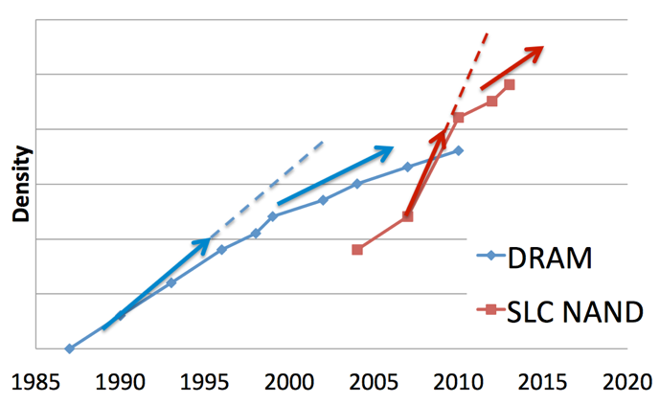
NVDIMM
Store data in DRAM backed by NAND Flash
Capacity is hard to scale

Slide 42
Phase-Change Memory (PCM)
Store data within phase-change material
  Amorphous phase: high resistivity (0)
  Crystalline phase : low resistivity (1)
Set phase via current pulse
  Fast cooling → Amorphous
  Slow cooling → Crystalline
Notes:
Amorphous 非晶态
Crystalline 晶体

Slide 43
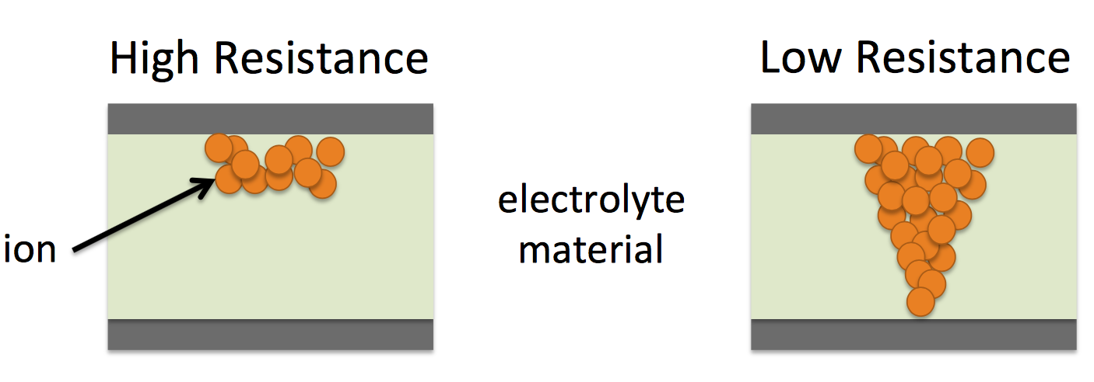
Resistive RAM (RRAM)
Store data by dissolving ions within electrolyte memristive material (e.g., TiOx)
Notes:
Electrolyte 电解液
离子

Slide 44
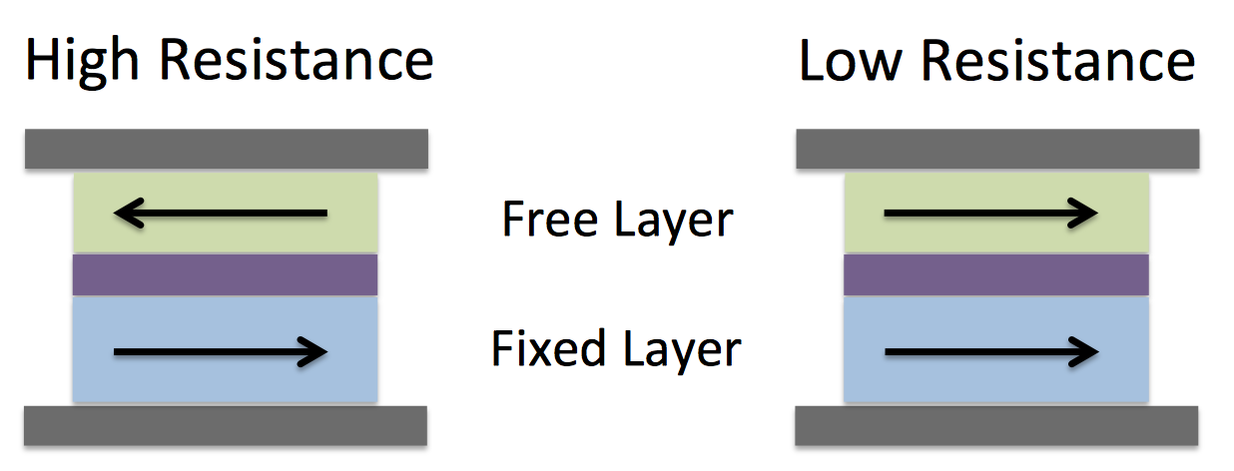
Spin-Transfer Torque RAM (STT-RAM)
Store data within magnetic-tunnel junction
  Anti-parallel orientation: high resistance (0)
  Parallel orientation: low resistance (1)
Notes:
Torque 扭转力

Slide 45
3D-XPoint
Fig. from Intel

Slide 46
3D-XPoint
Fig. from Intel

Slide 47
3D-XPoint
Intel Optane SSD 800P
Intel Optane DC Persistent Memory
Fig. from Intel

Slide 48
3D-XPoint
Intel Optane SSD 800P
Intel Optane DC Persistent Memory
Byte-addressable
Wear-leveling still needed
Perisistence
Higher density (512GB/DIMM)
<10X slower than DRAM
Less bandwidth than DRAM
Block interface
No erase (thus, no GC) necessary
Smaller/stable latency
Wear-leveling still needed
Fig. from Intel

Slide 49
Summary

Slide 50
Fast File System
UNIX File System
  Slow due to random access (bad locality)
Fast File System
  Cylinder groups & Fragments
  Parameterization
  Layout policies
  Functional enhancements
Q: How to design/optimize file systems for different scenarios?

Slide 51
New Storage and Media
Flash & SSD
  NOR vs. NAND
  SLC, MLC, TLC, QLC
  P/E cycle, FTL, GC, endurance
  Open-channel SSD
SMR
  Overlapping tracks for higher density
  Sequential writes, random reads
NVM
  NVDIMM, PCM, RRAM, STT-RAM
  3D-XPoint SSD
  3D-XPoint Persistent Memory
    Byte-addressability
    Near-DRAM performance
    Persistence
Q: How to design/optimize file systems for different media/storage?

Slide 52
Questions
Design/Optimize file systems for
  sparse files?
  large directories?
  log files?
  SMR disks?
  an SSD with a small NVM?

